Slide 1
Developers Usage of ChatGPT
Maya Patel, Jacob Radzieta, Samuel Vacca, Jeffrey Ober, Jeremy Roller

Slide 2
Outline
▶ Context
▶ Problem
▶ Solution
▶ Approach overview
▶ Results
▶ Takeaways

Slide 3
Context
ChatGpt is used by individuals as well as companies
Some companies or developers may use DevGpt an extension on ChatGPT
Helps developers edit code using AI that simplifies code and reduce the amount of errors
Data can be shared in a way that multiple developers can collaborate and improve each others code
Acts as a band-aid as development may be limited to previous solutions

Slide 4
Outline
▶ Context
▶ Problem
▶ Solution
▶ Approach overview
▶ Results
▶ Takeaways

Slide 5
Problem
Problem 1: What are developers using ChatGPT for when it comes to sharing work?
Problem 2: When ChatGPT is used, what is its purpose? (Direct/Indirect reference)

Slide 6
Outline
▶ Context
▶ Problem
▶ Solution
▶ Approach overview
▶ Results
▶ Takeaways

Slide 7
Solution
Source: Combined_PR_Sharing Excel Spreadsheet
For both problems #1 and #2
Allowed us to find common instances of ChatGPT being used
As a creator and tool

Slide 8
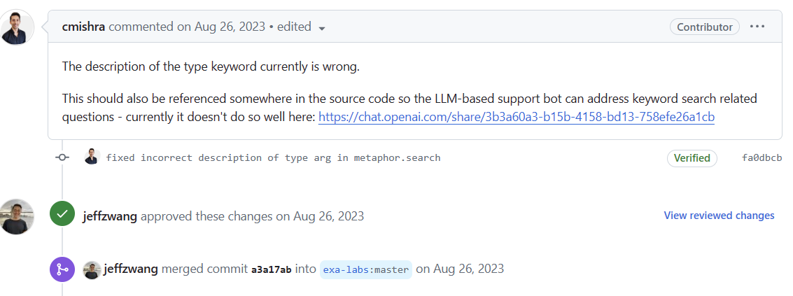
Solution (cont.)

Slide 9
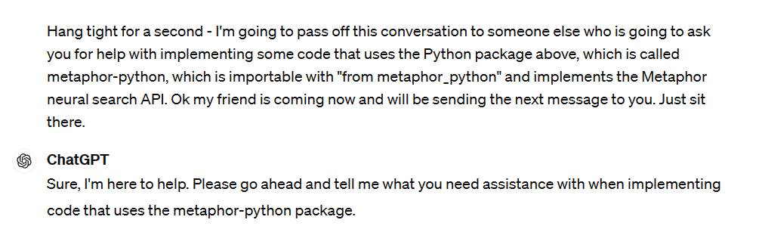
Solution (cont.)

Slide 10
Outline
▶ Context
▶ Problem
▶ Solution
▶ Approach overview
▶ Results
▶ Takeaways

Slide 11
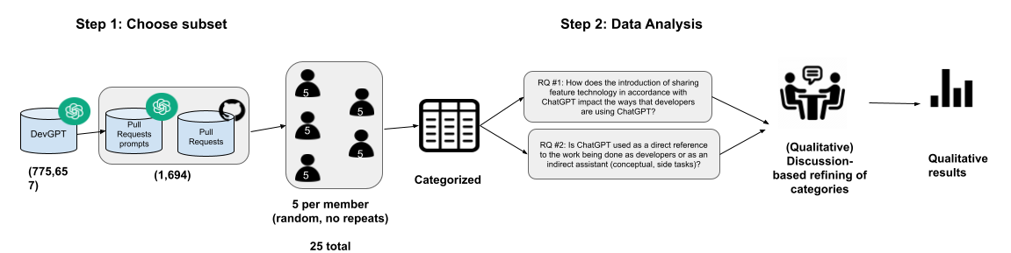
Approach Overview
▶ Developers using the pull request feature along with ChatGPT
▶ Manual quantitative and qualitative analysis
▶ Discussion-based data categorization
Notes:
We wanted to see the motivations behind develops use of chatgpt and also their reasons for submitting a pull request and sharing their prompts with other developers.
To do this, we used a manual approach. We used the pull requests chatpGpt conversation as well as the github messages linked to them from the database to see why they were using chatgpt and why they were sharing it with other developers.
We each chose 5 instances (and checked for repeats) then qualitatively read the prompts and messages.
We individually catergorized data.
Once that was done, we had a group discussion to further define groupings based on simialrieis and to decrease outliers.
We did this process for each research question.
After that, we quantified ou data with graphical representations.

Slide 12
Outline
▶ Context
▶ Problem
▶ Solution
▶ Approach overview
▶ Results
▶ Takeaways

Slide 13
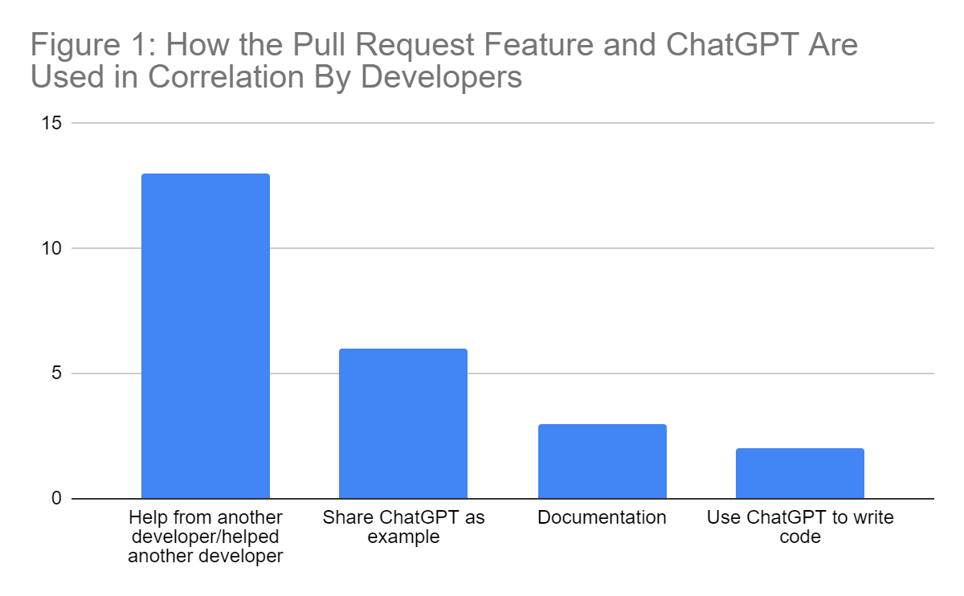
Results
Developers most often aided others with minimal ChatGPT
ChatGPT examples were often used
Not often directly writing code for project

Slide 14
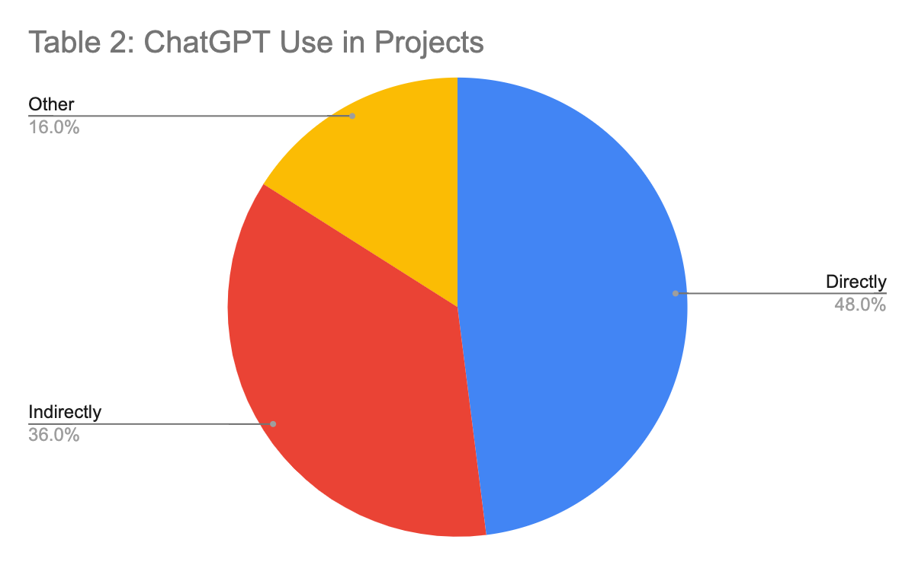
Results
48% of developers used ChatGPT code directly
36% of developers used ChatGPT code directly
16% of developers used used ChatGPT in other way

Slide 15
Outline
▶ Context
▶ Problem
▶ Solution
▶ Approach overview
▶ Results
▶ Takeaways

Slide 16
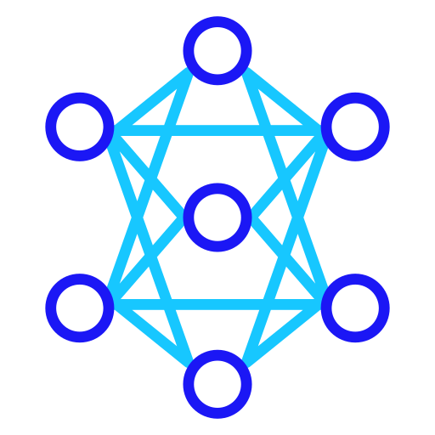
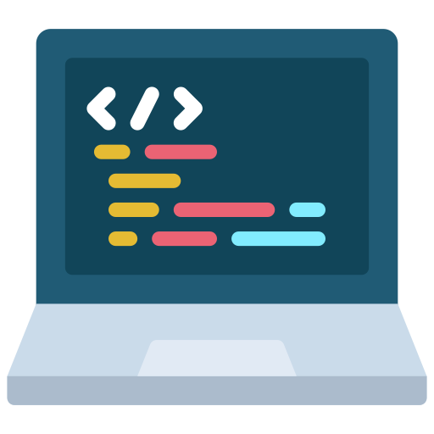
Takeaways
▶ Increased team collaboration through ChatGPT sharing features
▶ Coding translational abilities within teams
▶ Direct vs. indirect implementation (Github, developers)
▶ Code improvements

Slide 17
Introduction: In the vast landscape of artificial intelligence, our collaborative journey with Professor Alomar has been nothing short of enlightening. Through countless hours of brainstorming, coding, and analysis, we've embarked on a transformative expedition, uncovering layers of insight and innovation. In this comprehensive narrative, we delve deep into the heart of our AI project, unraveling its complexities and extracting invaluable takeaways that will shape our understanding of AI for years to come. Chapter 1: The Genesis of Exploration Our voyage began with a spark of curiosity and a shared vision for harnessing AI's potential. Under the guidance of Professor Alomar, we navigated through the intricate terrain of problem formulation, data acquisition, and model selection. Each decision was meticulously crafted, laying the foundation for our expedition into the realm of AI. Chapter 2: Data as the Compass In the vast ocean of AI, data serves as our guiding compass, illuminating the path forward. Through rigorous data collection and preprocessing, we unearthed hidden patterns and insights, transforming raw information into actionable intelligence. Professor Alomar's expertise in data wrangling proved invaluable, ensuring that our models were fueled by quality inputs and robust foundations. Chapter 3: Charting New Territories with Model Exploration With our data compass in hand, we embarked on the exhilarating journey of model exploration. From classical algorithms to cutting-edge neural networks, we traversed a diverse landscape of methodologies, each offering unique insights and challenges. Professor Alomar's encyclopedic knowledge of AI architectures provided us with a treasure trove of techniques to explore, empowering us to push the boundaries of innovation. Chapter 4: Navigating the Storms of Optimization As we charted new territories, we encountered turbulent storms of optimization, where performance enhancements clashed with computational constraints. Through meticulous tuning and experimentation, we navigated these challenges with precision, fine-tuning our models to strike the delicate balance between accuracy and efficiency. Professor Alomar's expertise in optimization algorithms served as our guiding light, illuminating the path towards peak performance. Chapter 5: Insights from the Expedition Amidst the rigors of our expedition, we gleaned profound insights that transcended the realm of AI. Collaboration emerged as a cornerstone of our success, fostering synergy and innovation at every turn. Professor Alomar's mentorship provided us with not only technical expertise but also invaluable wisdom, guiding us through the complexities of AI with unwavering support and encouragement. Chapter 6: The Legacy of Discovery As our AI project draws to a close, its legacy endures as a testament to the power of exploration and collaboration. The knowledge gained and lessons learned will serve as beacons of inspiration for future endeavors, igniting the flames of curiosity and innovation in generations to come. With deep gratitude to Professor Alomar and our team, we embark on new horizons, armed with the transformative insights gleaned from our AI odyssey. Conclusion: In the tapestry of our AI project, each thread represents a moment of discovery, a lesson learned, and a leap of innovation. Through collaboration, perseverance, and unwavering dedication, we've unlocked the boundless potential of artificial intelligence, paving the way for a future shaped by endless possibilities. As we bid farewell to this chapter of our journey, we carry with us the profound takeaways and indelible memories that will continue to inspire and propel us forward.Introduction: In the vast landscape of artificial intelligence, our collaborative journey with Professor Alomar has been nothing short of enlightening. Through countless hours of brainstorming, coding, and analysis, we've embarked on a transformative expedition, uncovering layers of insight and innovation. In this comprehensive narrative, we delve deep into the heart of our AI project, unraveling its complexities and extracting invaluable takeaways that will shape our understanding of AI for years to come. Chapter 1: The Genesis of Exploration Our voyage began with a spark of curiosity and a shared vision for harnessing AI's potential. Under the guidance of Professor Alomar, we navigated through the intricate terrain of problem formulation, data acquisition, and model selection. Each decision was meticulously crafted, laying the foundation for our expedition into the realm of AI. Chapter 2: Data as the Compass In the vast ocean of AI, data serves as our guiding compass, illuminating the path forward. Through rigorous data collection and preprocessing, we unearthed hidden patterns and insights, transforming raw information into actionable intelligence. Professor Alomar's expertise in data wrangling proved invaluable, ensuring that our models were fueled by quality inputs and robust foundations. Chapter 3: Charting New Territories with Model Exploration With our data compass in hand, we embarked on the exhilarating journey of model exploration. From classical algorithms to cutting-edge neural networks, we traversed a diverse landscape of methodologies, each offering unique insights and challenges. Professor Alomar's encyclopedic knowledge of AI architectures provided us with a treasure trove of techniques to explore, empowering us to push the boundaries of innovation. Chapter 4: Navigating the Storms of Optimization As we charted new territories, we encountered turbulent storms of optimization, where performance enhancements clashed with computational constraints. Through meticulous tuning and experimentation, we navigated these challenges with precision, fine-tuning our models to strike the delicate balance between accuracy and efficiency. Professor Alomar's expertise in optimization algorithms served as our guiding light, illuminating the path towards peak performance. Chapter 5: Insights from the Expedition Amidst the rigors of our expedition, we gleaned profound insights that transcended the realm of AI. Collaboration emerged as a cornerstone of our success, fostering synergy and innovation at every turn. Professor Alomar's mentorship provided us with not only technical expertise but also invaluable wisdom, guiding us through the complexities of AI with unwavering support and encouragement. Chapter 6: The Legacy of Discovery As our AI project draws to a close, its legacy endures as a testament to the power of exploration and collaboration. The knowledge gained and lessons learned will serve as beacons of inspiration for future endeavors, igniting the flames of curiosity and innovation in generations to come. With deep gratitude to Professor Alomar and our team, we embark on new horizons, armed with the transformative insights gleaned from our AI odyssey. Conclusion: In the tapestry of our AI project, each thread represents a moment of discovery, a lesson learned, and a leap of innovation. Through collaboration, perseverance, and unwavering dedication, we've unlocked the boundless potential of artificial intelligence, paving the way for a future shaped by endless possibilities. As we bid farewell to this chapter of our journey, we carry with us the profound takeaways and indelible memories that will continue to inspire and propel us forward.Introduction: In the vast landscape of artificial intelligence, our collaborative journey with Professor Alomar has been nothing short of enlightening. Through countless hours of brainstorming, coding, and analysis, we've embarked on a transformative expedition, uncovering layers of insight and innovation. In this comprehensive narrative, we delve deep into the heart of our AI project, unraveling its complexities and extracting invaluable takeaways that will shape our understanding of AI for years to come. Chapter 1: The Genesis of Exploration Our voyage began with a spark of curiosity and a shared vision for harnessing AI's potential. Under the guidance of Professor Alomar, we navigated through the intricate terrain of problem formulation, data acquisition, and model selection. Each decision was meticulously crafted, laying the foundation for our expedition into the realm of AI. Chapter 2: Data as the Compass In the vast ocean of AI, data serves as our guiding compass, illuminating the path forward. Through rigorous data collection and preprocessing, we unearthed hidden patterns and insights, transforming raw information into actionable intelligence. Professor Alomar's expertise in data wrangling proved invaluable, ensuring that our models were fueled by quality inputs and robust foundations. Chapter 3: Charting New Territories with Model Exploration With our data compass in hand, we embarked on the exhilarating journey of model exploration. From classical algorithms to cutting-edge neural networks, we traversed a diverse landscape of methodologies, each offering unique insights and challenges. Professor Alomar's encyclopedic knowledge of AI architectures provided us with a treasure trove of techniques to explore, empowering us to push the boundaries of innovation. Chapter 4: Navigating the Storms of Optimization As we charted new territories, we encountered turbulent storms of optimization, where performance enhancements clashed with computational constraints. Through meticulous tuning and experimentation, we navigated these challenges with precision, fine-tuning our models to strike the delicate balance between accuracy and efficiency. Professor Alomar's expertise in optimization algorithms served as our guiding light, illuminating the path towards peak performance. Chapter 5: Insights from the Expedition Amidst the rigors of our expedition, we gleaned profound insights that transcended the realm of AI. Collaboration emerged as a cornerstone of our success, fostering synergy and innovation at every turn. Professor Alomar's mentorship provided us with not only technical expertise but also invaluable wisdom, guiding us through the complexities of AI with unwavering support and encouragement. Chapter 6: The Legacy of Discovery As our AI project draws to a close, its legacy endures as a testament to the power of exploration and collaboration. The knowledge gained and lessons learned will serve as beacons of inspiration for future endeavors, igniting the flames of curiosity and innovation in generations to come. With deep gratitude to Professor Alomar and our team, we embark on new horizons, armed with the transformative insights gleaned from our AI odyssey. Conclusion: In the tapestry of our AI project, each thread represents a moment of discovery, a lesson learned, and a leap of innovation. Through collaboration, perseverance, and unwavering dedication, we've unlocked the boundless potential of artificial intelligence, paving the way for a future shaped by endless possibilities. As we bid farewell to this chapter of our journey, we carry with us the profound takeaways and indelible memories that will continue to inspire and propel us forward.Introduction: In the vast landscape of artificial intelligence, our collaborative journey with Professor Alomar has been nothing short of enlightening. Through countless hours of brainstorming, coding, and analysis, we've embarked on a transformative expedition, uncovering layers of insight and innovation. In this comprehensive narrative, we delve deep into the heart of our AI project, unraveling its complexities and extracting invaluable takeaways that will shape our understanding of AI for years to come. Chapter 1: The Genesis of Exploration Our voyage began with a spark of curiosity and a shared vision for harnessing AI's potential. Under the guidance of Professor Alomar, we navigated through the intricate terrain of problem formulation, data acquisition, and model selection. Each decision was meticulously crafted, laying the foundation for our expedition into the realm of AI. Chapter 2: Data as the Compass In the vast ocean of AI, data serves as our guiding compass, illuminating the path forward. Through rigorous data collection and preprocessing, we unearthed hidden patterns and insights, transforming raw information into actionable intelligence. Professor Alomar's expertise in data wrangling proved invaluable, ensuring that our models were fueled by quality inputs and robust foundations. Chapter 3: Charting New Territories with Model Exploration With our data compass in hand, we embarked on the exhilarating journey of model exploration. From classical algorithms to cutting-edge neural networks, we traversed a diverse landscape of methodologies, each offering unique insights and challenges. Professor Alomar's encyclopedic knowledge of AI architectures provided us with a treasure trove of techniques to explore, empowering us to push the boundaries of innovation. Chapter 4: Navigating the Storms of Optimization As we charted new territories, we encountered turbulent storms of optimization, where performance enhancements clashed with computational constraints. Through meticulous tuning and experimentation, we navigated these challenges with precision, fine-tuning our models to strike the delicate balance between accuracy and efficiency. Professor Alomar's expertise in optimization algorithms served as our guiding light, illuminating the path towards peak performance. Chapter 5: Insights from the Expedition Amidst the rigors of our expedition, we gleaned profound insights that transcended the realm of AI. Collaboration emerged as a cornerstone of our success, fostering synergy and innovation at every turn. Professor Alomar's mentorship provided us with not only technical expertise but also invaluable wisdom, guiding us through the complexities of AI with unwavering support and encouragement. Chapter 6: The Legacy of Discovery As our AI project draws to a close, its legacy endures as a testament to the power of exploration and collaboration. The knowledge gained and lessons learned will serve as beacons of inspiration for future endeavors, igniting the flames of curiosity and innovation in generations to come. With deep gratitude to Professor Alomar and our team, we embark on new horizons, armed with the transformative insights gleaned from our AI odyssey. Conclusion: In the tapestry of our AI project, each thread represents a moment of discovery, a lesson learned, and a leap of innovation. Through collaboration, perseverance, and unwavering dedication, we've unlocked the boundless potential of artificial intelligence, paving the way for a future shaped by endless possibilities. As we bid farewell to this chapter of our journey, we carry with us the profound takeaways and indelible memories that will continue to inspire and propel us forward.

Slide 18
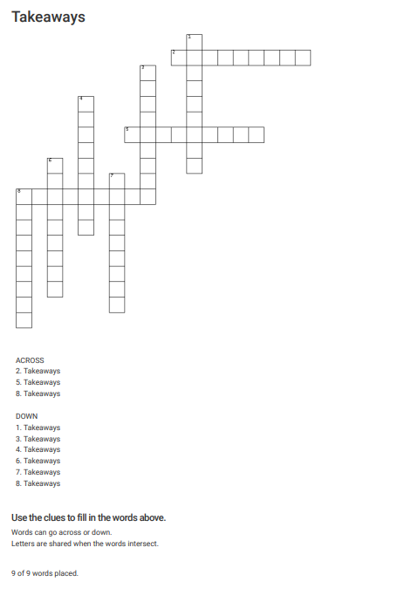
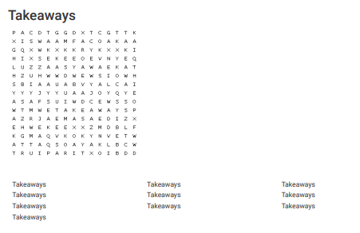

Slide 19
Thank you!

